Slide 1
Erasmus Mundus
Call for Proposals 2013
EACEA/38/2012

Slide 2
Erasmus Mundus - objectives
Enhance the quality of European HE through international co-operation
Improve the development of human resources
Promote dialogue and understanding between peoples and cultures
Promote Europe as a centre of excellence in learning around the world

Slide 3
Policy context → programme aims
Erasmus Mundus
Promote European higher education
Promote intercultural understanding
Improve career prospects
Bologna
process
EU 2020
EU external relations
3

Slide 4
Action 1
Joint Masters and Doctoral Programmes
implemented by EU and non-EU HEIs
full-study scholarships for students; grants for visiting scholars
Action 2
Partnerships
EU and non-EU HEIs
scholarships for short-term or degree-seeking student mobility at a range of levels, and for staff
Action 3
Promotional projects
raise profile of European higher education
tackle challenges of international higher education cooperation

Slide 5
Action 1 Joint Programmes
In 2013:
138 Masters Courses and 43 Joint Doctorates will offer:
1,500 + Masters scholarships, 300 doctoral fellowships, 450 scholar scholarships
Instances of participation:745 EU, 240 non-EU
2004-2012:
Scholarships for over 14,000 masters students, 2,000 scholars and 640 doctoral candidates

Slide 6
Action 1 scholarships
Two categories of students/doctoral candidates:
Category A:
Non-Europeans who are not resident, nor have carried out their main activity for more than a total of 12 months over the last 5 years, in a European country
Category B:
Any individual fulfilling the academic admission conditions set by the consortium and who does not fulfil Category A requirements (mainly Europeans)

Slide 7
Masters scholarships
 |  | Category A scholarships (1-2 years) | Category B scholarships (1-2 years) | Academics’ scholarships
I | Contrib. to travel and other types of personal costs | € 4 000 per year | € 3 000 - only if mobility to a non-EUR partner
II | Contrib. to participation costs: e.g.fees & insurance | Max € 4 000 per semester | Max € 2 000 per semester
III | Monthly allowance | € 1 000 per month | € 500 per month
IV | Living allowance (incl. travel costs) |  |  | €1200 per week for max. 3 months
Total |  | € 24 000 per year | € 10 000 per year ( + € 3 000 if travel) | € 14 400 for a max. 3-mth stay

Slide 8
Doctorate fellowships
 |  | Category A fellowship (amounts for a 3-year doctoral fellowship) | Category B fellowship (amounts for a 3-year doctoral fellowship)
I | Contrib. to travel, installation and other personal costs | € 7500 | € 3000 (if mobility to non-EUR partner)
II | Fixed contrib. to the EMJD participation costs | € 300 per month (€ 10 800 for 36 months) for non-laboratory based EMJDs € 600 per month (€ 21 600 for 36 months) for laboratory based EMJDs
III | Fixed living allowance (36 months in total) | € 2 800 per month (i.e. € 100 800 for 36 months) for an employment contract € 1 400 per month (i.e. € 50 400 for 36 months) for a stipend
Maximum fellowship amount |  | Between € 61 200 and € 129 900 (depending on category, lab. or type of recruitment)

Slide 9
What is a Call for Proposals?
Calls for Proposals and selections are managed by the Education, Audiovisual and Culture Executive Agency (EACEA) on behalf of the European Commission
2013 Call (EACEA/38/12) launched December 2012
Deadline for proposals: 15 April 2013
Assessment by independent experts
Targets:
- 62 Action 2 Partnerships
- 8 Action 3 Projects
Selection to be completed by July 2013
9

Slide 10
What’s new in 2013?
Earlier deadline: 15 April 2013
No Action 1 Call (Masters Courses and Joint Doctorates)
Action 2 Call:
mobility for EU nationals to developing countries
- new country lots: Brazil, Tunisia, Uzbekistan
- increased budget
- eForm application
Action 3 Call:
- increased budget
- eForm application
Action 2 assessment: additional elements
Importance of geographical coverage : EU and non—EU partners
Past/current performance of partnership: management capacity
10

Slide 11
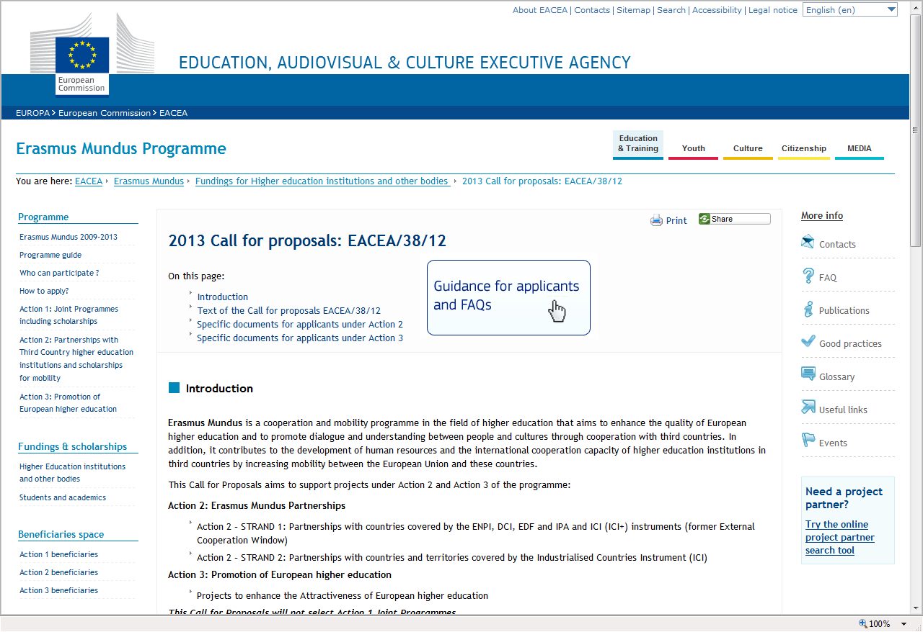
Check the Call documents & guidance
Check the official Call documents published on the Agency website before starting your application:
http://eacea.ec.europa.eu/erasmus_mundus/funding/2013/call_eacea_38_12_en.php
Guidance for applicants

Slide 12
Key Documents for your application (1) Programme Guide
Programme objectives, activities, eligibility criteria, conditions for support
For use with each Call for Proposals documents, Guidelines for Applicants (Action 2) and Application Forms and Instructions
Latest version December 2012, valid for 2013 Call http://eacea.ec.europa.eu/erasmus_mundus/programme/programme_guide_en.php
Check what's new in the Programme Guide:
http://eacea.ec.europa.eu/erasmus_mundus/programme/documents/2013/2013_whatsnew_pg_dec2012.pdf

Slide 13
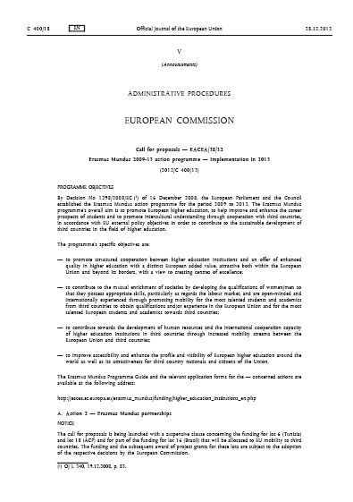
Key Documents for your application (2): Call for Proposals in Official Journal
Brief Erasmus Mundus programme description
Budget and number of projects to be selected in 2013
Award criteria
Priorities under Action 3
Submission deadline

Slide 14
Key Documents for your application (3): For Action 2 only: Specific guidelines
Lists geographical lots
Budget per lot → minimum mobility flows
Thematic priorities (disciplines)
Specific criteria for partners/partnerships
Types of mobility funded and duration

Slide 15
Action 2 partnerships
Submitting an application
EACEA/38/2012

Slide 16
Action 2 Partnerships
Partnerships between HEIs from EU + non-EU HEIs from a specific region
Emphasise cooperation, transfer of know-how
Scholarships of varying lengths (3 months to 3 years) for academic disciplines offered by HEIs in the partnership
Bachelor, Masters, Doctorate, Post-Doctorate students + HEI staff (training, teaching, research)
2013 Call aims to select 62 partnerships

Slide 17
Action 2 Partnerships
At least 5 European HEIs from at least 3 EU countries
At least 1 HEI from each country in geographic lot
Maximum size partnership: 20 partners
€ 10,000 per partner flat rate for partnership management (max € 200,000)
Scholarships cover costs of travel, subsistence, participation (fees), insurance and visa

Slide 18
An Action 2 partnership
Target Group I
Target Group II & III
MID: http://www.utu.fi/mid
9 European universities
FI (Turku, coordinator)
GR
DE
PO
IT
FR
ES
PL
LT
11 universities from Eastern Partnership countries
4 Belarus
4 Ukraine
1 Moldova
1 Armenia
1 Georgia

Slide 19
Common & specific elements in the lots
Common to all Action 2 lots
A range of target groups for mobility
A range of duration for mobility
Up to 5 levels of higher education covered
Project must start operations in year of selection (year ‘n’)
Mobility may start in different ‘cohorts’ throughout partnership life
Possible 'joint coordinator' role for one of the non-EU partners
Specific to individual lots (See Guidelines)
Which target groups covered by mobility
Which levels of higher education covered
Thematic fields of study
Partnership composition

Slide 20
Action 2 Partnerships, 2007-2012
215 partnerships worldwide
3915 instances of participation: 1752 EU, 2163 non-EU
Around 34,000 mobility flows implemented or planned

Slide 21
Action 2 Partnerships in 2012-2013
53 partnerships selected in 2012.
All offering mobility in 2012 and/or 2013
Over 8,000 scholarships planned
46 partnerships selected in 2011.
Many will still be offering mobility in 2012/2013
Almost all regions of the world covered

Slide 22
Action 2 scholarships - coverage
Monthly allowance
Tuition and registration costs
Insurance
Travel costs, according to distance-based flat rates

Slide 23
Amounts for Action 2 scholarships
Type | Monthly subsistence | Duration (months) | Tuition/ Registration | Insurance (per month) | Maximum (excl travel)
Masters | € 1 000 | 1 sem – 24 m | € 3000 if > 10m - Fee waiver if stay below 10 months | € 75 | € 31 800
Doctorate | € 1 500 | 6 – 36 | € 3000 for min 10 m | € 75 | € 65 700
Post-Doctorate | € 1 800 | 6 – 10 | No unit costs. € 5000 per acad yr for specialised postdoc studies | € 75 | € 23 750
Staff | € 2 500 | 1 - 3 | n.a. | € 75 | € 7 725

Slide 24
2013 Call – Action 2 targets
Action 2: Strand 1 (countries covered by ENPI, DCI & ICI+, EDF, IPA)
18 lots for 57 partnerships
Total budget EUR 187.4 million
Mobility for minimum 6,877 individuals

Slide 25
2013 Call – Action 2 targets
Action 2: Strand 2 (countries covered by ICI)
4 lots for 5 partnerships
Total budget EUR 6.75 million
Mobility for minimum 142 individuals

Slide 26
Proposed shape of lots:
Action 2 Call 2013 (neighbouring countries)
Proposed n° of partnerships:
x
Lot 4
Russia
2
3
4
Lot 7
Albania, Bosnia & Herzegovina FYROM, Kosovo*, Montenegro, Serbia
Lot 5
Belarus, Moldova, Ukraine, Armenia, Azerbaijan, Georgia
Lot 9
Kazakhstan, Kyrgyzstan, Tajikistan, Turkmenistan, Uzbekistan
9
NEW!
Lot 10
Uzbekistan country lot
2
NEW!
Lot 6
Tunisia country lot
1
1
Lot 2
Jordan, Lebanon,
OPT, Syria
Lot 3
Israel
4
Lot 1
Morocco, Algeria, Tunisia, Libya, Egypt
4
*This designation is without prejudice to positions on status, and is in line with UNSCR 1244 and the ICJ Opinion on the Kosovo Declaration of Independence

Slide 27
Proposed shape of lots:
Action 2 Call 2013 (rest of the world)
Proposed n° of partnerships:
x
2
Lot 1
North America
1
4
Lot 8
Iran Iraq Yemen
1
Lot 3
Japan
Korea
Lot 11
Asia West
Lot 4
Gulf countries
1
4
Lot 13
India
Lot 12
Asia East
Lot 15
Latin America
(C)
3
4
Lot 18
ACP countries
2
3
NEW!
Lot 16
Brazil
Lot 14
Latin America
(S)
3
3
Lot 17
South Africa
1
Lot 4
Australia New Zealand
Strand 1
Strand 2

Slide 28
Action 2 Award Criteria: Strand 1
1. Relevance (25%)
2. Quality (65% total)
2.1. Partnership composition and cooperation mechanisms (20%)
2.2. Organisation and implementation of mobility (25%)
2.3. Student/staff facilities and follow-up (20%)
3. Sustainability (10%)

Slide 29
Action 2 Award Criteria: Strand 2
1.Relevance (25%)
2. Contribution to excellence (25%)
3. Quality (50% total)
3.1. Partnership composition and cooperation mechanisms (15%)
3.2. Organisation and implementation of mobility (20%)
3.3. Student/staff facilities and follow-up (15%)

Slide 30
Action 2 Use of the eForm
Applications to be submitted using an eForm
Static version of eForm available second half of January
Shows structure and required content of eForm
Provides all annexes required to be uploaded within the eForm
Final version of eForm available 1 March 2013

Slide 31
Action 2 Main elements of your application (1)
Identification of applicant and other organisations
Description of the project
Technical capacity of applicant consortium
Declaration on Honour

Slide 32
Action 2 Main elements of your application (2)
Budget
Partnership statement signed by all partners
Project summary sheet for publication on EACEA website
Bank account form
Legal entity form

Slide 33
Action 2: Submit your application
The eForm application will be considered as the original version.
1 paper copy identical to the eForm application must be posted to the Agency by the deadline indicated at the following address:
Education, Audiovisual and Culture Executive Agency
Call for proposals EACEA/38/12 – Action 2
BOUR 02/029
Avenue du Bourget, 1
BE-1140 Bruxelles

Slide 34
Action 3 promotion projects
Submitting an application
EACEA/38/2012

Slide 35
Action 3: Promotion of European Higher Education
Action 3 provides support to transnational initiatives, studies, projects, events and other activities aimed at enhancing the attractiveness, profile, image and visibility of, and accessibility to, European higher education in the world.

Slide 36
Erasmus Mundus - Action 3 to date
9 promotion projects selected in 2012
75 promotion projects 2004-2012
577 instances of participation by 433 different HE organisations (221 from Europe, 212 from third countries)
10 information projects managed by National Structures (2010-2012)
5 Clusters of existing Erasmus Mundus projects (2010-2012)
36

Slide 37
2013 Call – Action 3 targets
Budget: EUR 2 million
Target: 8 projects
Indicative project size: from EUR 100,000 to 350,000
European co-financing to max 75%
Project duration: 12 – 36 months
Min. 3 European and 1 third-country partner

Slide 38
2013 Call – Action 3 priorities
Action 3 priority areas – projects aiming at:
Promotion of European higher education in certain geographical areas (Eastern and Southern neighbourhood countries)
Improving services for international students
Addressing the international dimension of Quality Assurance
Promoting the joint programmes towards students
Promoting the joint programmes towards employers
Creating better synergies between the EU policy dialogue with third countries and the cooperation projects supported by the European programmes in higher education.
38
Notes:
38

Slide 39
Action 3 project requirements
Clear European dimension and wide geographical scope
Clear international (third-country) dimension
Must contribute to fostering intercultural dialogue and mutual understanding between cultures
Ensure no overlap with other EU programmes for higher education

Slide 40
Action 3 Award Criteria
Relevance to Erasmus Mundus Programme (25%)
Expected impact to enhance attractiveness of European higher education worldwide (25%)
Dissemination of results and experiences, quality assurance, sustainability and exploitation of results (15%)
Consortium composition and cooperation mechanisms (15%)
Work plan and budget (20%)

Slide 41
Action 3: Use of the eForm
Applications to be submitted using an eForm
Static version of eForm available second half of January
Shows structure and required content of eForm
Provides all annexes required to be uploaded within the eForm
Final version of eForm available 1 March 2013

Slide 42
Action 3: Main elements of your application (1)
Identification of applicant and partners
Organisation and activities
Project identification
Project title
Priority area covered
Duration
Summary description of the project
Detailed project description (award criteria responses)
Budget

Slide 43
Action 3: Main elements of your application (2)
Work Plan
CVs of persons responsible in each partner
Letters of endorsement, Declarations on Honour from partner organisations)
Legal status documentation
Financial identification
Privacy statement and information
Checklist
Declaration on Honour by the legal representative of the applicant organisation
Model Declaration on Honour by partner organisation
Detailed Budget

Slide 44
Action 3: Main elements of your application budget
Indication of total budget and EU grant requested (max 75% of total budget)
Composition of the partnership contribution
Staff costs
Travel and subsistence
Equipment
Subcontracting
Conferences-Seminars:
Organisation costs
Travel and subsistence costs of participants and speakers
Interpreters
Speaker fees
Other direct costs
Indirect costs (max 7% of direct costs)
New: light audit report - costs eligible

Slide 45
Action 3: Submit your application
The eForm application will be considered as the original version.
1 paper copy identical to the eForm application must be posted to the Agency by the deadline indicated at the following address:
Education, Audiovisual and Culture Executive Agency
Call for proposals EACEA/38/12 – Action 3
BOUR 02/029
Avenue du Bourget, 1
BE-1140 Bruxelles

Slide 46
Erasmus Mundus selection process
Action 2
Action 3
EACEA: Eligibility and selection criteria
EU Delegations:
Eligibility non-EU HEIs
Relevance regional priorities
External experts: Assessment of proposals
Evaluation Committee
Selection Decision
Evaluation Committee
Selection Decision

Slide 47
More information http://eacea.ec.europa.eu/erasmus_mundus/index_en.php
Programme Guide
Calls for Proposals
FAQs
Good practice
Selected projects
Partner search
Beneficiaries’ space
47
http://eacea.ec.europa.eu/erasmus_mundus/index_en.php

Slide 48
Questions on the Call?
Erasmus Mundus mailbox:
EACEA-Erasmus-Mundus@ec.europa.eu

Slide 49
Update on other HE programmes

Slide 50
Intra-ACP academic mobility scheme
Partnerships of universities from ACP countries (Lot 1 Africa, Lot 2 Caribbean and Pacific)
Partner universities from ACP countries only (possible for technical partners from EU)
Scholarships for ACP nationals to study agreed Masters and Doctoral programmes offered by partner universities

Slide 51
Intra-ACP Call 2013
To be confirmed: check Call for actual budget & details
Third Call for Proposals
Budget (EUR 23.45m)twice the 2012 amount
Plans to selected 7 partnerships for Africa, 2-3 for Caribbean and Pacific
Planned launch January 2013
Deadline 29 April 2013

Slide 52
Three bilateral cooperation programmes
ICI-ECP (Industrialised Countries Instrument-Education Cooperation Programme):
EU-Australia/Japan/New Zealand /Republic of Korea
EU-US ATLANTIS (no more calls foreseen)
EU-CANADA (no more calls foreseen)

Slide 53
ICI-ECP Call 2013
2013 Call published 14 December 2012
Deadline for applications 15/05/2013
Budget from EU side: approximately 2.45 M€
Plan to fund 5-9 cooperation projects
Cooperation projects: EU and one Partner Country
Joint Mobility projects
Joint Degree projects

Slide 54
Jean Monnet Programme
Key activity 1: Jean Monnet Action (call for proposals)
Key activity 2: Support for specified institutions dealing with issues relating to European integration
Key activity 3: European associations active at European level in the field of education and training (call for proposals)

Slide 55
Jean Monnet 2013 Call
Deadline: 15 February 2013
http://eacea.ec.europa.eu/llp/funding/2013/call_jean_monnet_action_ka1_2013_en.php
EACEA-AJM@ec.europa.eu

Slide 56
The future
Erasmus Mundus 2009-2013
Erasmus for All 2014-2020
Programme for education, youth, culture and sport
Rationale: streamline EU support in all areas
Strong international component

Slide 57
Erasmus for All: international cooperation
The new programme will maintain support for:
Mobility for students and staff from non-EU countries
Joint masters degrees with scholarships
Programmes for intra-university cooperation on capacity-building
Policy dialogue on higher education between EU and rest of the world

